Slide 1
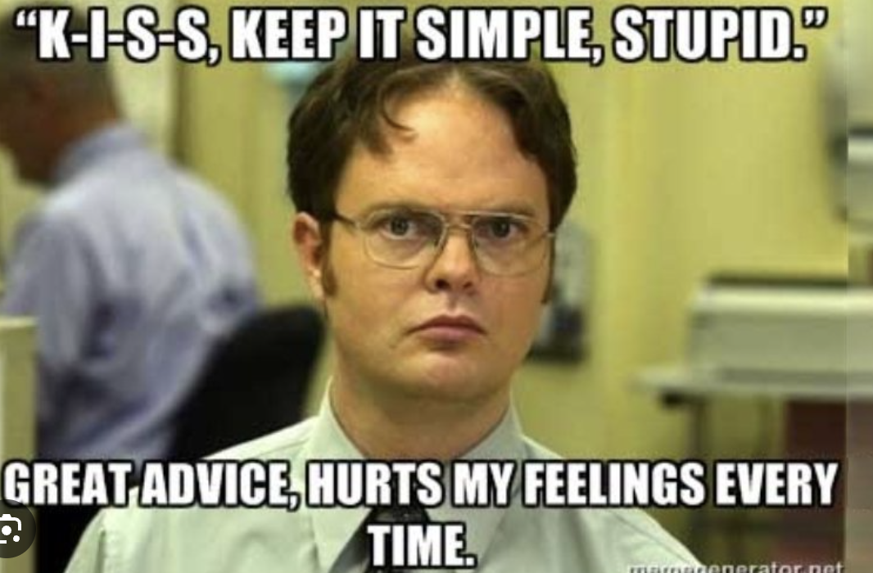
Tachycardia: Pre-Hospital Management of Cardiac Presentations
Jeff Wisniowski DO, MPH
EMS Director Charter Care
Section Chair Emergency Medicine Practice and Health Policy ACEP
Notes:
Thank you everyone for coming tonight.
I want to thank and recognize all of you who I have met and spoke with. This talk is born out of your suggestions and our conversations.
We did low and slow now its on to fast and fierce which is more our speed in the ER, caffeine and junk food.
Cardiac conversations can be dense it is easy to get lost, this is an orienting point discussing differentials this is not a discussion of EKG morphology because that is learned by review and active learning w/conversations and patient presentations.
Asking these three questions will help classify any tachydysrhythmia in most cases.
1. Regular or irregular?
2. Narrow or wide QRS?
3. Are there P waves? P-QRS relationship? How many P waves for each QRS?

Slide 2
Objectives
Identify and define elements of sinus tachycardia
Describe the differential diagnosis of tachycardia
Identify types of wide complex and narrow complex tachycardia
Discuss treatment and pre-hospital care for supraventricular tachycardia

Slide 5
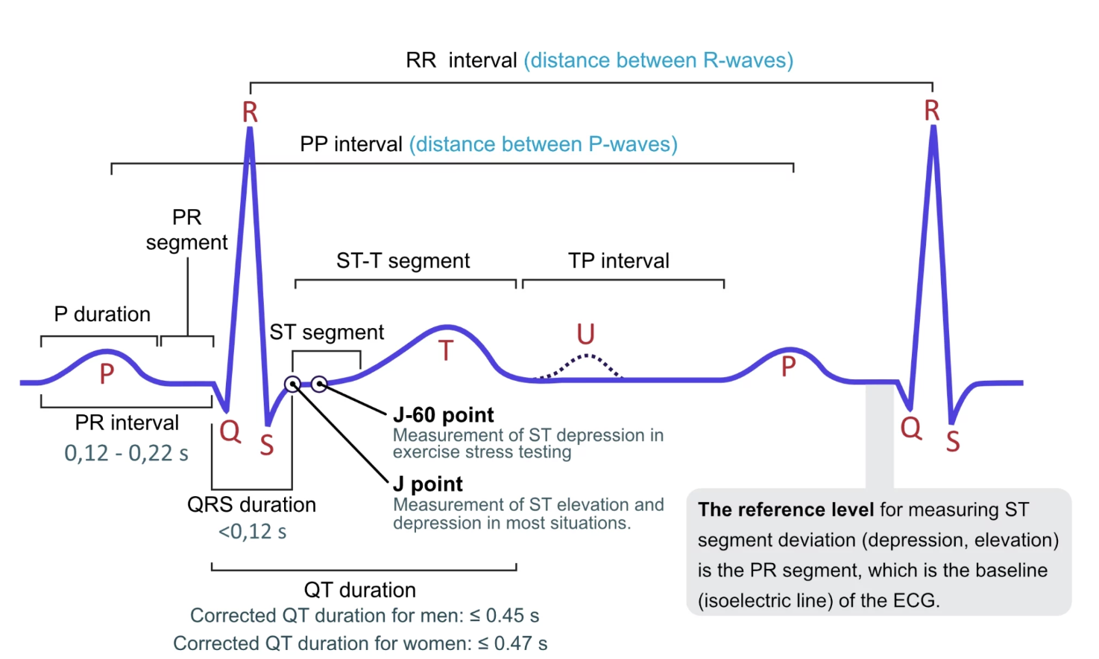
Notes:
Regular rhythm at a rate of 60-100 bpm (or age-appropriate rate in children)
Each QRS complex is preceded by a normal P wave
Normal P wave axis: P waves upright in leads I and II, inverted in aVR
The PR interval remains constant
QRS complexes < 100 ms wide (unless co-existent interventricular conduction delay present)

Slide 6
Notes:
Lead II is
the rhytym determining strip

Slide 7
Stable vs. Unstable
Hypotension
Decreased Consciousness
Heart Failure due to arrythmia
Acute Ischemic Chest Pain
Notes:
The ACLS definition and the practical clinical situation
What are their baseline pressures?
Is the patient mentating?
Do they have comorbidities, HF, Cardiomyopathy, elderly?
Ischemia is this heart tissue not perfusing?
Grey, Diminished LOC, sinus pauses.

Slide 8
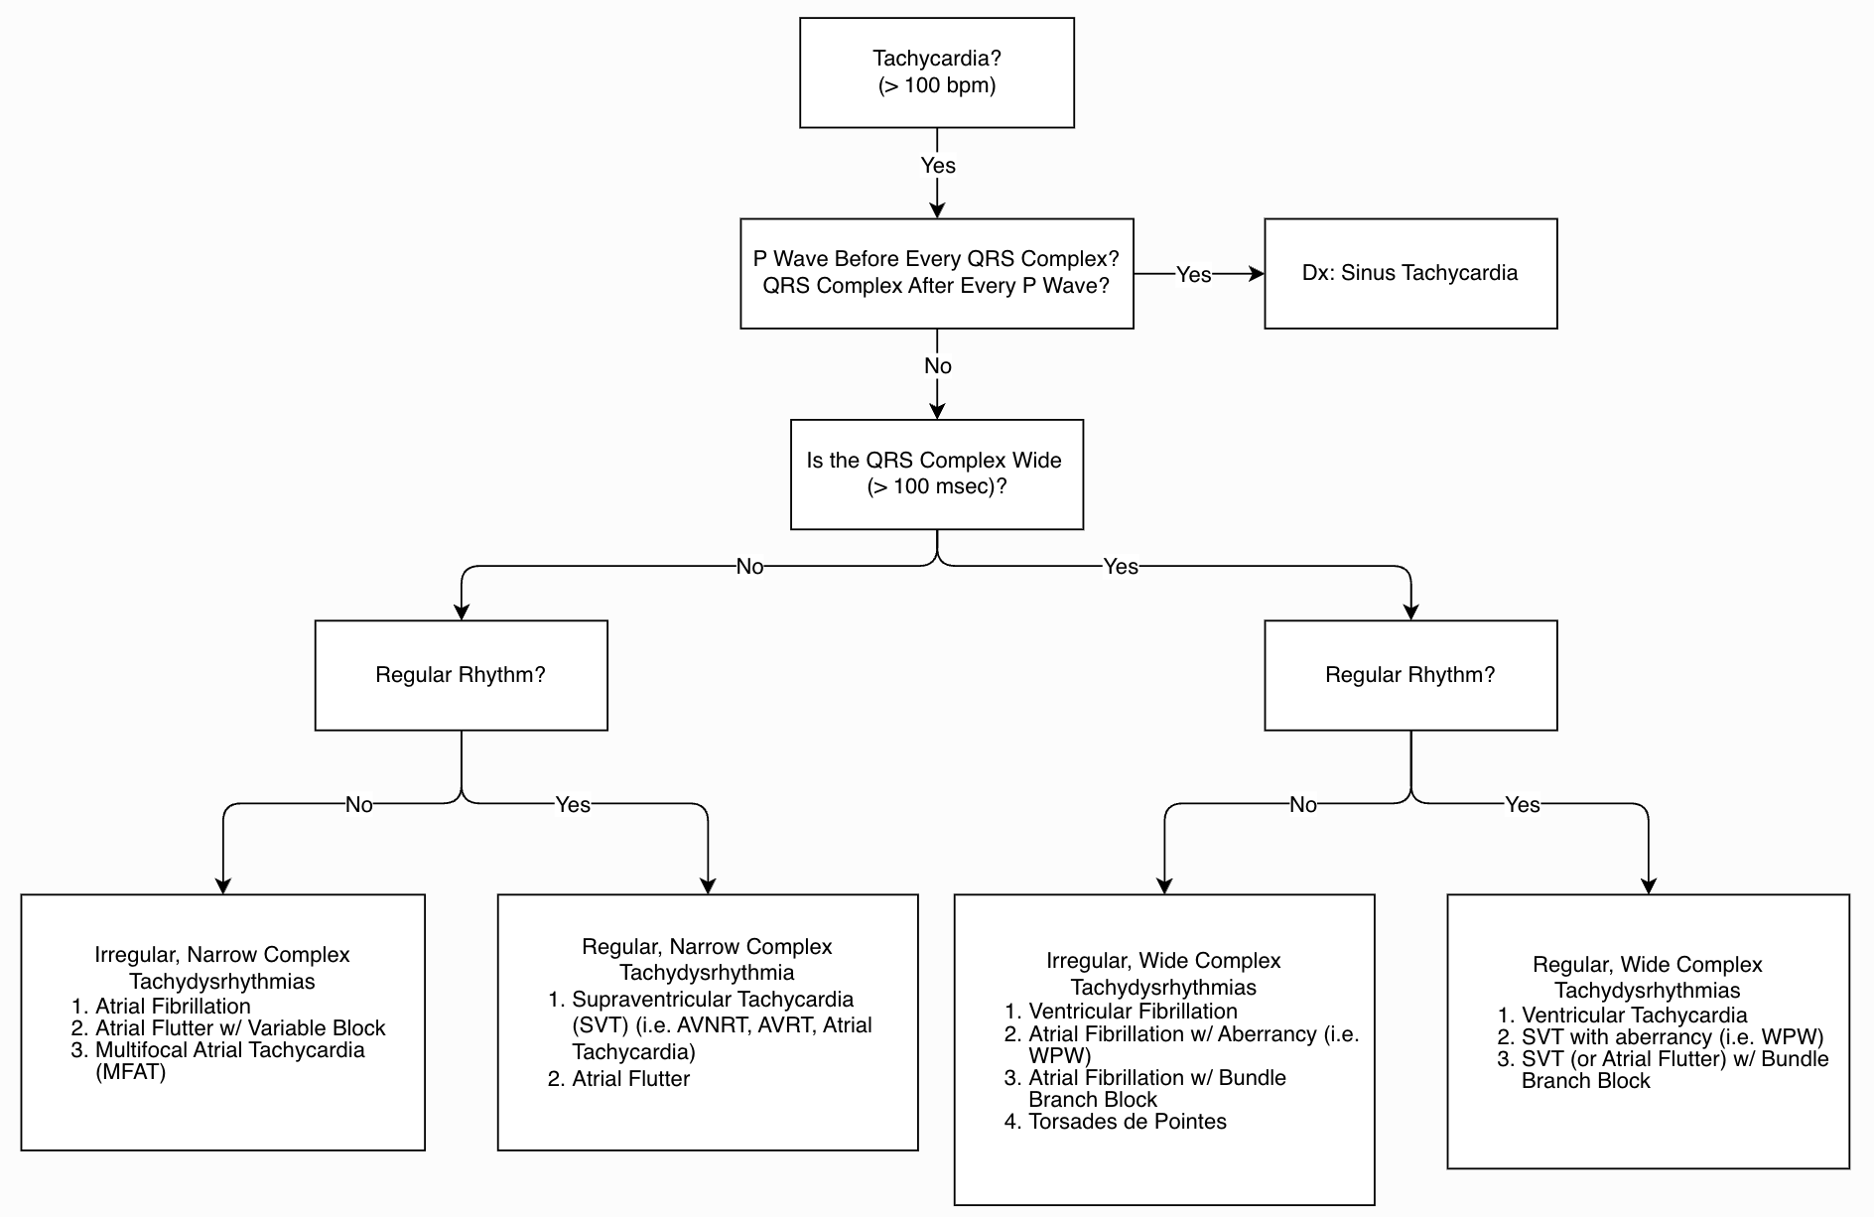

Slide 9
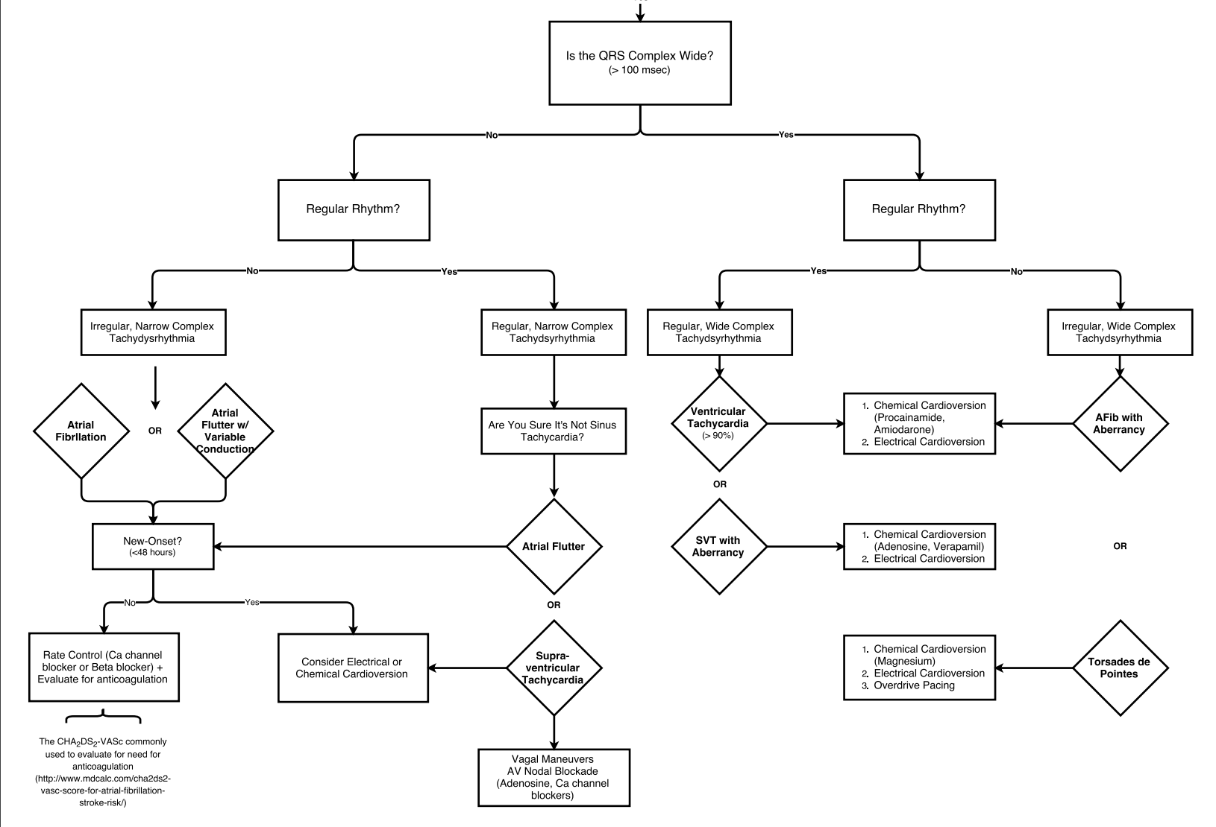

Slide 10
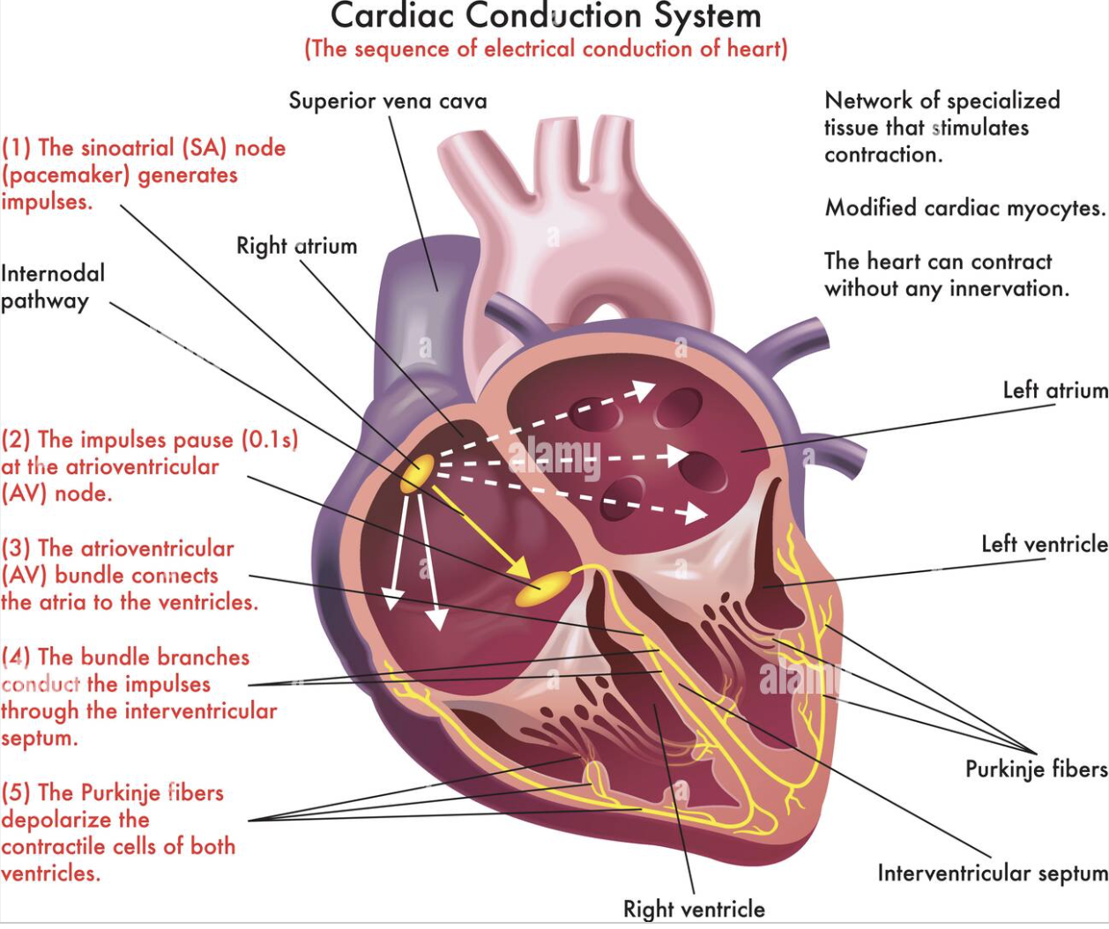

Slide 11
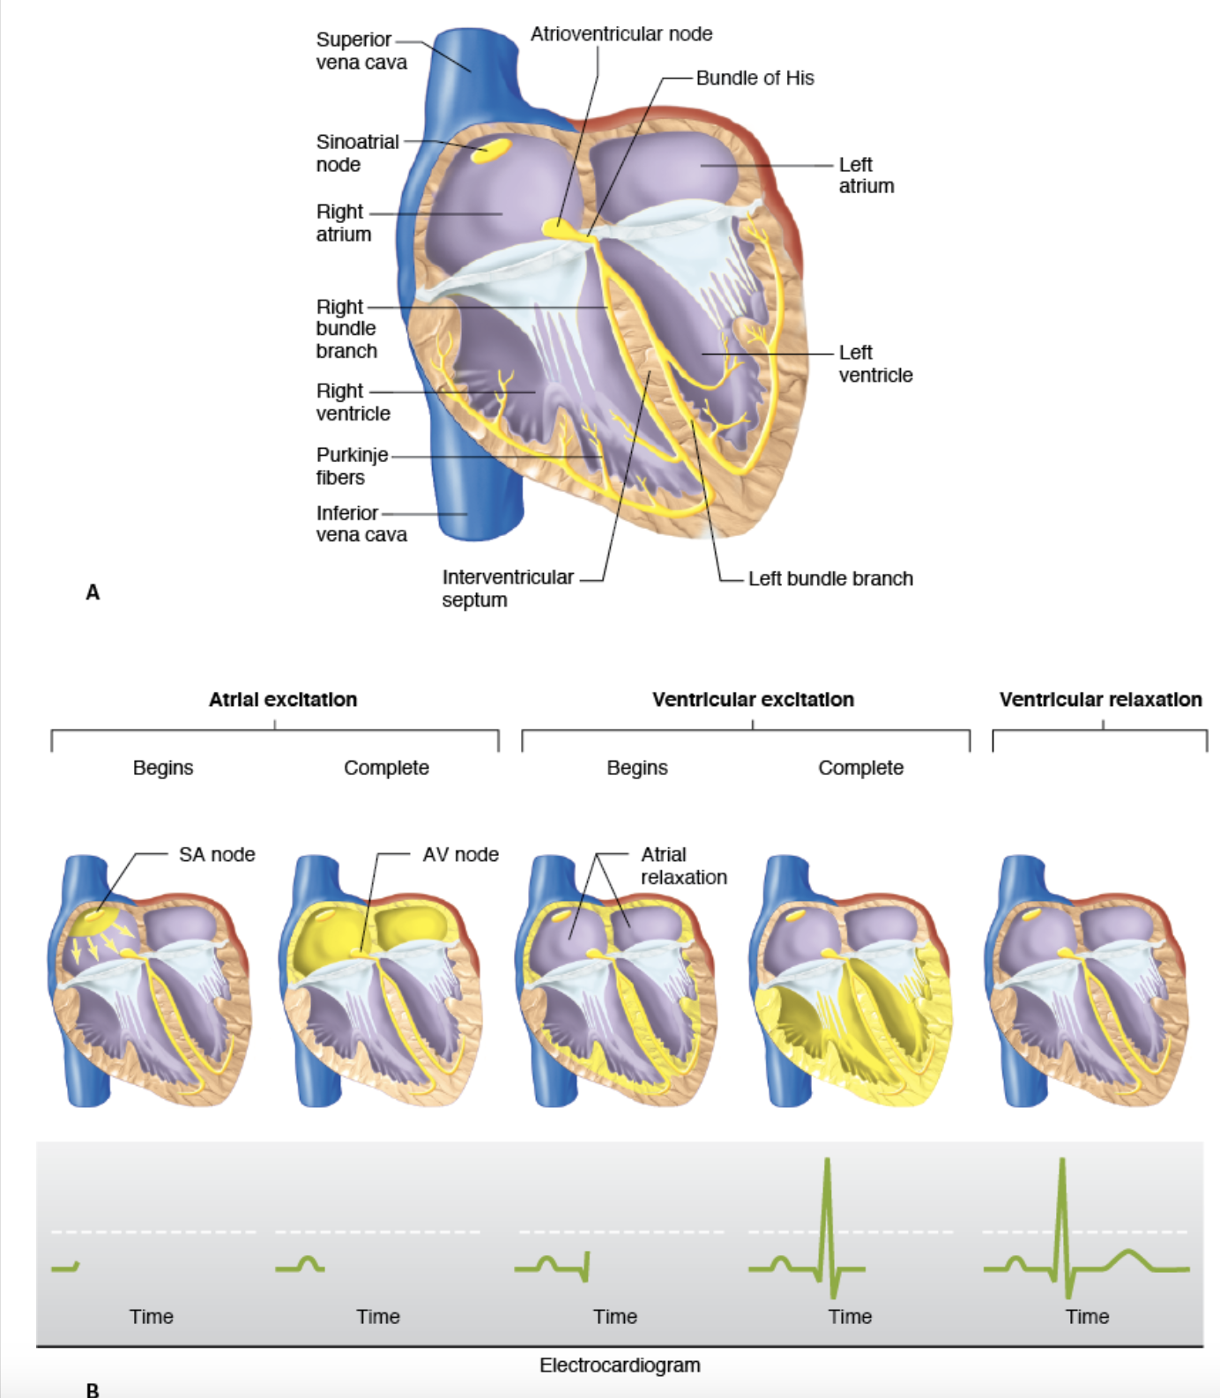

Slide 12
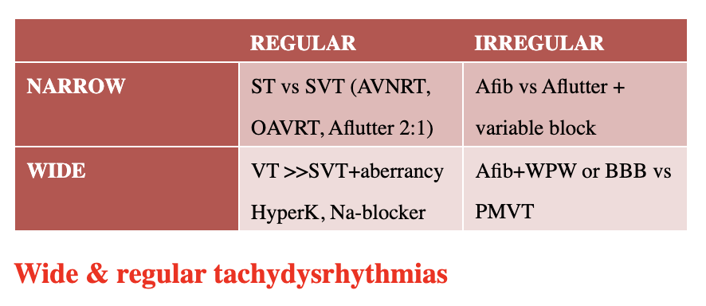
Tachycardia and Tachydysrhythmia's
Abnormal cardiac rhythm with a rate >100 BPM
Types
SVT
MFAT
VT
VF
Torsades
Notes:
Tachydysrhythmias are defined as any abnormal cardiac rhythm with a rate greater than 100 beats per minute.
220 - Age is the max heart rate so 20 can be 200 80 can be 140
The tachydysrhythmias include a large number of diagnoses including atrial (atrial fibrillation/flutter, supraventricular tachycardia (SVT), multifocal atrial tachycardia (MFAT)) and ventricular dysrhythmias (ventricular tachycardia (VT), ventricular fibrillation (VF) and Torsades de Pointes). These disorders are common and patients can present in extremis making it critical for emergency providers to be able to rapidly distinguish between tachydysrhythmias and initiate management.
Sinus tachycardia should be considered a reactive rhythm, occurring in response to a triggering condition. Generally, sinus tachycardia is a benign rhythm without any end-organ dysfunction

Slide 13
HPI and PE – The Chief Complaint
“Find The CC”
Patients Presentation
PMHx
Medications
Physical, EKG and Glucose
MOLST/DNR/DNI
Notes:
Remember that although advanced age makes a wide complex tachycardia VT much more likely than SVT with aberrancy, up to 50% of patients under 40 years of age who present with a wide complex regular tachycardia with have VT. In addition, response to adenosine does not rule out VT.
It is critical to gather as much information from the patient, scene and supporting information – bystanders, PMHx etc.
What is this patient vulnerable to? What are the co-morbidities, a first time symptomatic patient vs. a patient with a midline sternotomy incision or nursing home patient
Meds – are they on digoxin, amiodirone?
Interventions – pacemaker, defibrillator, Watchman and LVADs
Initial assessment
STAT fingerstick glucose.
Vital signs, neuro exam
Review current medication list.
Review home medication list (withdrawal?).
Review recent events & procedures.

Slide 14
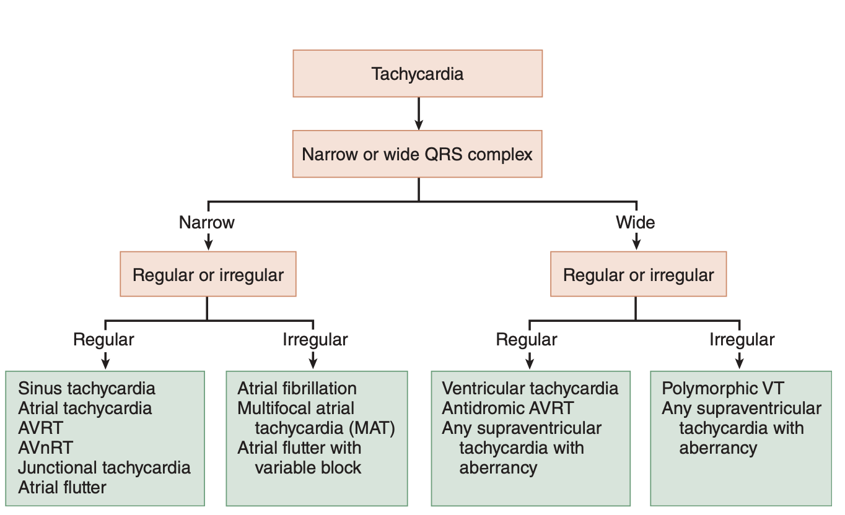
Notes:
Build a mental model of how you will organize this, go on the internet review.

Slide 15
Notes:
QRS < 0.12 secs and rate >150
Consider close observation and monitoring!

Slide 16
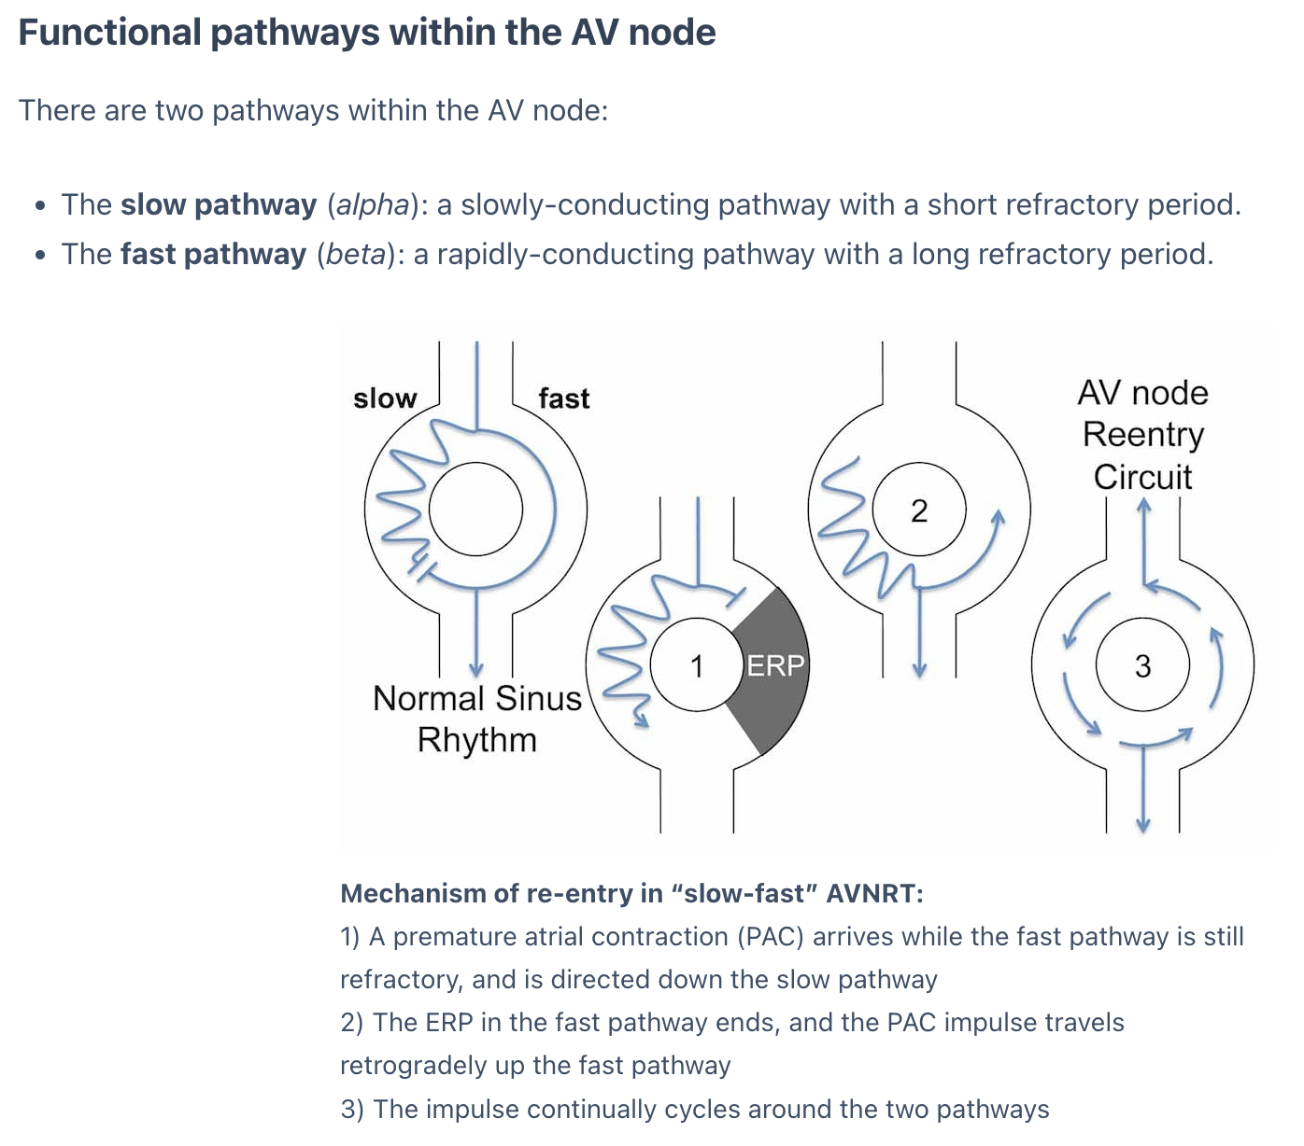
Notes:
Initiation of re-entry
During normal sinus rhythm, electrical impulses travel down both pathways simultaneously. The impulse transmitted down the fast pathway enters the distal end of the slow pathway and the two impulses cancel each other out
However, if a premature atrial contraction (PAC) arrives while the fast pathway is still refractory, the electrical impulse will be directed solely down the slow pathway (1)
By the time the premature impulse reaches the end of the slow pathway, the fast pathway is no longer refractory, and the impulse is permitted to recycle retrogradely up the fast pathway (2)
This creates a circus movement whereby the impulse continually cycles around the two pathways, activating the Bundle of His anterogradely and the atria retrogradely (3)
The short cycle length is responsible for the rapid heart rate
This most common type of re-entrant circuit is termed Slow-Fast AVNRT
Similar mechanisms exist for the other types of AVNRT

Slide 17
Notes:
Regular tachycardia ~140-280 bpm
Narrow QRS complexes (< 120ms) unless there is co-existing bundle branch block, accessory pathway, or rate-related aberrant conduction
P waves if visible exhibit retrograde conduction with P-wave inversion in leads II, III, aVF. They may be buried within, visible after, or very rarely visible before the QRS complex

Slide 18
Interventions
Notes:
SVT Treatment
Vagal maneuvers
The REVERT trial that compared the effectiveness of a modified vs. “standard” Valsalva blowing into a 10cc synringe to convert SVT to sinus rhythm showed a NNT = 3, however real world experience does not seem as promising. This difference may be due to the study control group being seated in the “standard” Valsalva group as apposed to supine.
What is the preferred medication for conversion of SVT to sinus rhythm, Adenosine or Calcium Channel Blockers (CCBs)?
Diltiazem is at least as effective as adenosine for conversion of SVT and has the advantage of lasting longer and not inducing an uncomfortable experience (often described as a feeling of near death) for the patient as observed with adenosine.
Unstable – synchronized cardioversion w/ sedation Midazolam
Adenosine 12mg rapid IV push arm up good line.
Diltiazem .25mg/kg max to 20mg, 10mg vs. Metoprolol – pick one and stick to it.
Maximum dose of antiarrhythmic should be given prior to changing to another antiarrhythmic.
Adenosine administration should be followed by a 10 ml flush of NS.
The initial dose for adenosine should be reduced to 6 mg and the repeat dose should be reduced to 12 mg in patients taking dipyridamole and those that are status post cardiac
transplant.
Theophylline and caffeine (methylxanthines) competitively antagonize adenosine's effects; an increased dose of adenosine may be required.

Slide 19
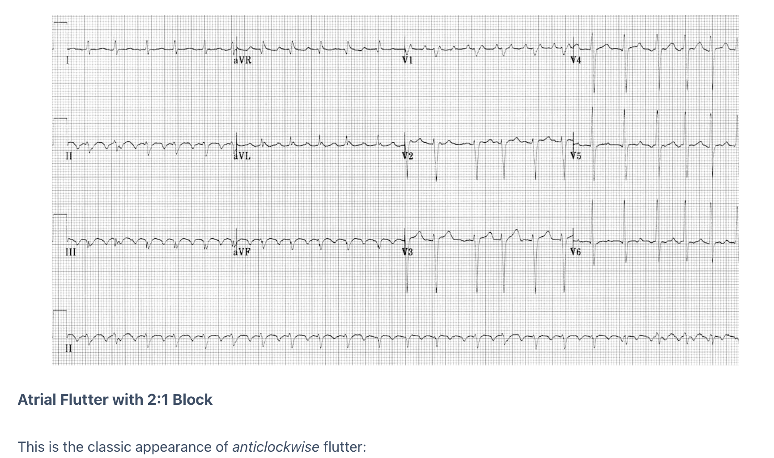
Atrial Flutter
Notes:
Narrow complex tachycardia
Regular atrial activity at ~300 bpm
Loss of the isoelectric baseline
“Saw-tooth” pattern of inverted flutter waves in leads II, III, aVF
Upright flutter waves in V1 that may resemble P waves
Ventricular rate depends on AV conduction ratio (see below)
Atrial flutter is a form of supraventricular tachycardia caused by a re-entry circuit within the right atrium. The length of the re-entry circuit corresponds to the size of the right atrium, resulting in a fairly predictable atrial rate of around 300 bpm (range 200-400)
Ventricular rate is determined by the AV conduction ratio (“degree of AV block”). The most common AV ratio is 2:1, resulting in a ventricular rate of ~150 bpm
Higher-degree blocks can occur — usually due to medications or underlying heart disease — resulting in lower rates of ventricular conduction, e.g. 3:1 or 4:1 block.
Atrial flutter with 1:1 conduction can occur due to sympathetic stimulation, or in the presence of an accessory pathway. The administration of AV-nodal blocking agents to a patient with Wolff-Parkinson-White syndrome can precipitate this
Atrial flutter with 1:1 conduction is associated with severe haemodynamic instability and progression to ventricular fibrillation
Handy Tips For Spotting Flutter
Rapid Recognition
Narrow complex tachycardia at 150 bpm (range 130-170)? Yes -> Suspect flutter!
Turn the ECG upside down and closely examine the inferior leads (II, III + aVF) for flutter waves
Vagal Manoeuvres +/- Adenosine
Atrial flutter will not usually cardiovert with these techniques (unlike AVNRT), although typically there will be a transient period of increased AV block during which flutter waves may be unmasked
RR intervals
In atrial flutter with variable block the R-R intervals will be multiples of the P-P interval — e.g. assuming an atrial rate of 300bpm (P-P interval of 200 ms), the R-R interval would be 400 ms with vent rate of ~150 w/ 2:1 block, 600 ms with 3:1 block or vent rate 100bpm, and 800 ms with 4:1 block
Look for identical R-R intervals occurring sporadically along the rhythm strip; then look to see whether there is a mathematical relationship between the various R-R intervals on the ECG
In contrast, atrial fibrillation will be completely irregular, with no patterns to be discerned within the R-R intervals
Unstable - synchornize cardioversion at less Jules ~50J
Preferred treats 96% of flutter
Amiodaron 150mg over 10 mins
Diltiazem 2.5 mg/kg over 10 mins
Stable PO manage
Cardioversion carries a risk 1.3% thromboembolism if on aspirin 2 after 48 hours, less effective when pretreatment of rate or rhythm control meds are used

Slide 20
Irregular: Atrial Fibrilation
Notes:
Irregularly irregular rhythm
No P waves
Absence of an isoelectric baseline
Variable ventricular rate
QRS complexes usually < 120ms, unless pre-existing bundle branch block, accessory pathway, or rate-related aberrant conduction
Fibrillatory waves may be present and can be either fine (amplitude < 0.5mm) or coarse (amplitude > 0.5mm)
Fibrillatory waves may mimic P waves leading to misdiagnosis
Rhythm control - synchronized cardioversion
Symptoms <48hrs no need to anticoagulate, key to speak with patient
Rate Control
Beta block - metoprolol 5mg IV q5min max x3 w/ PO after
Diltiazam 0.25 mg/kg then PO or drip
Digoxin w/HF or Amio
Anticoagulation is key CHADSVASC over 65
Other features:
Ashman Phenomenon – aberrant ventricular conducted beats, usually of RBBB morphology, secondary to a long refractory period as determined by the preceding R-R interval
The ventricular response and thus ventricular rate in AF is dependent on several factors including vagal tone, other pacemaker foci, AV node function, refractory period, and medications
AF is most commonly associated with a ventricular rate ~ 110 – 160
AF is often described as having ‘rapid ventricular response’ once the ventricular rate is > 100 bpm.
‘Slow’ AF is a term often used to describe AF with a ventricular rate < 60 bpm.
Causes of ‘slow’ AF include hypothermia, digoxin toxicity, and medications.
A connection between Sick Sinus Syndrome (SSS) or Sinus node dysfunction (SND) and atrial fibrillation (AF) has been recognized in the literature since the 1960s. There is some evidence to support AF inducing SND and some support for the notion that SND causes and promotes the development of AF. [Sinus Node Dysfunction in Atrial Fibrillation: Cause or Effect?, 2008]

Slide 21
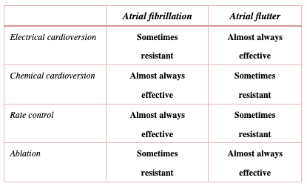
Atrial Fibrillation vs. Atrial Flutter
Notes:
First line agents for rate control in irregular tachycardias (atrial fibrillation) are calcium channel blockers. As per protocol, Adenosine may be considered to assist with diagnosis or if patient has history of Adenosine conversion, but Adenosine is NOT mandated.

Slide 23
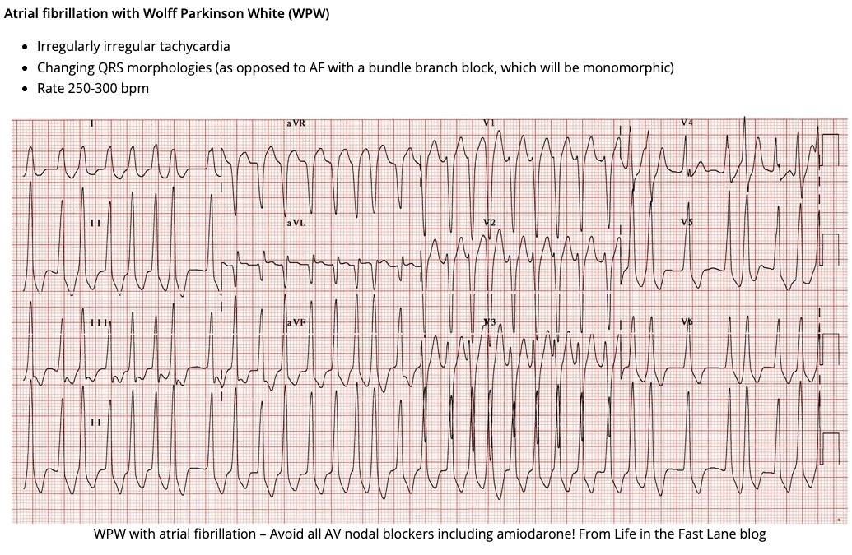
Notes:
Calcium channel blockers (diltiazem, verapamil) are contraindicated in patients with a known diagnosis of or with ECGs findings consistent with Wolff-Parkinson-White (WPW) syndrome, Lown-Ganong-Levine (LGL) or other pre-excitation syndromes.
Arrhythmias with suspicion of Wolff-Parkinson-White (WPW) syndrome should be treated with amiodarone following the dosing regimen in the wide complex tachycardia protocol.

Slide 24
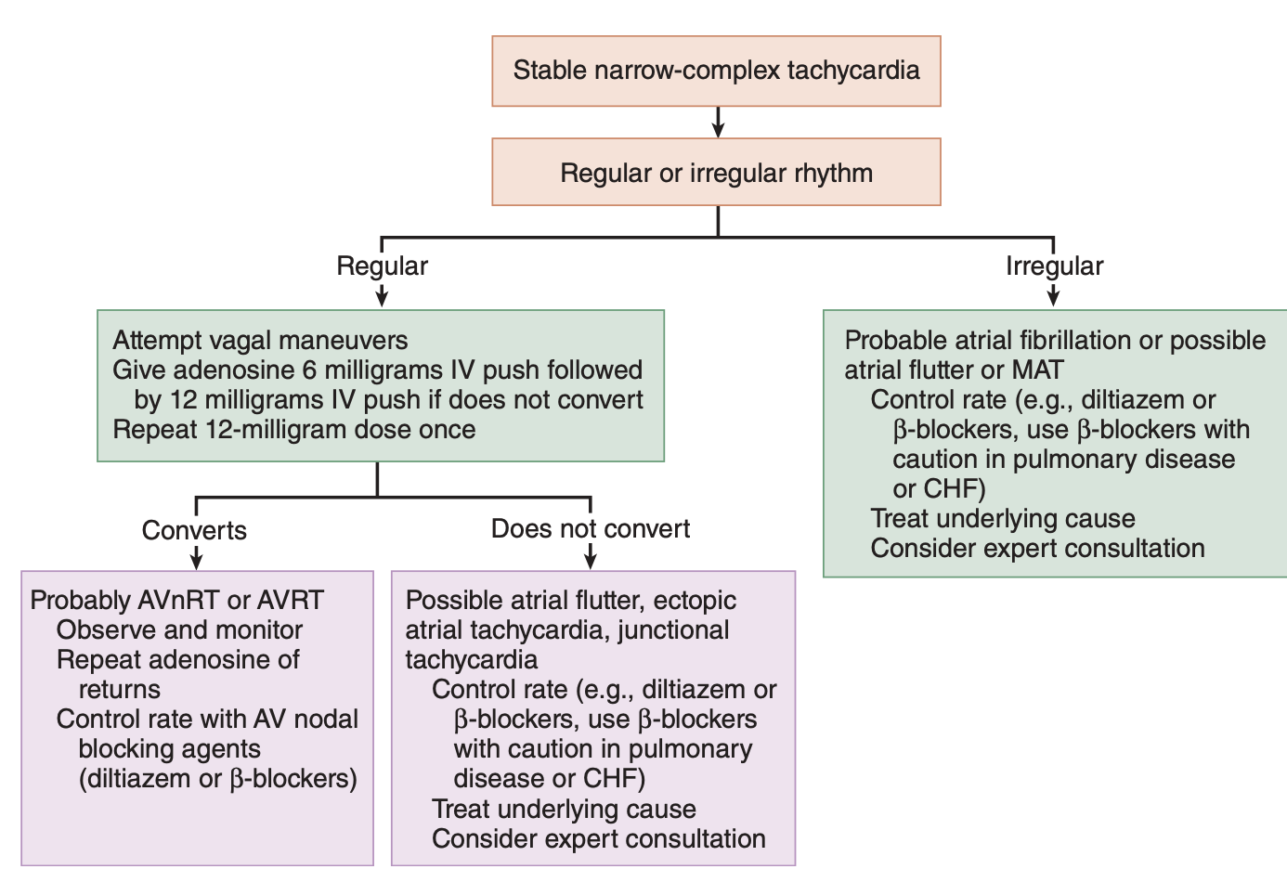
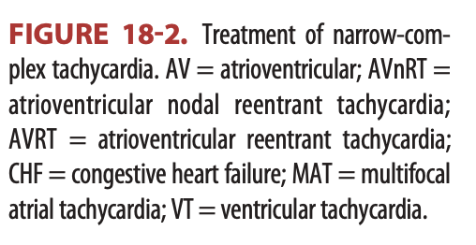
Notes:
Stable Narrow Complex Tachycardias

Slide 25
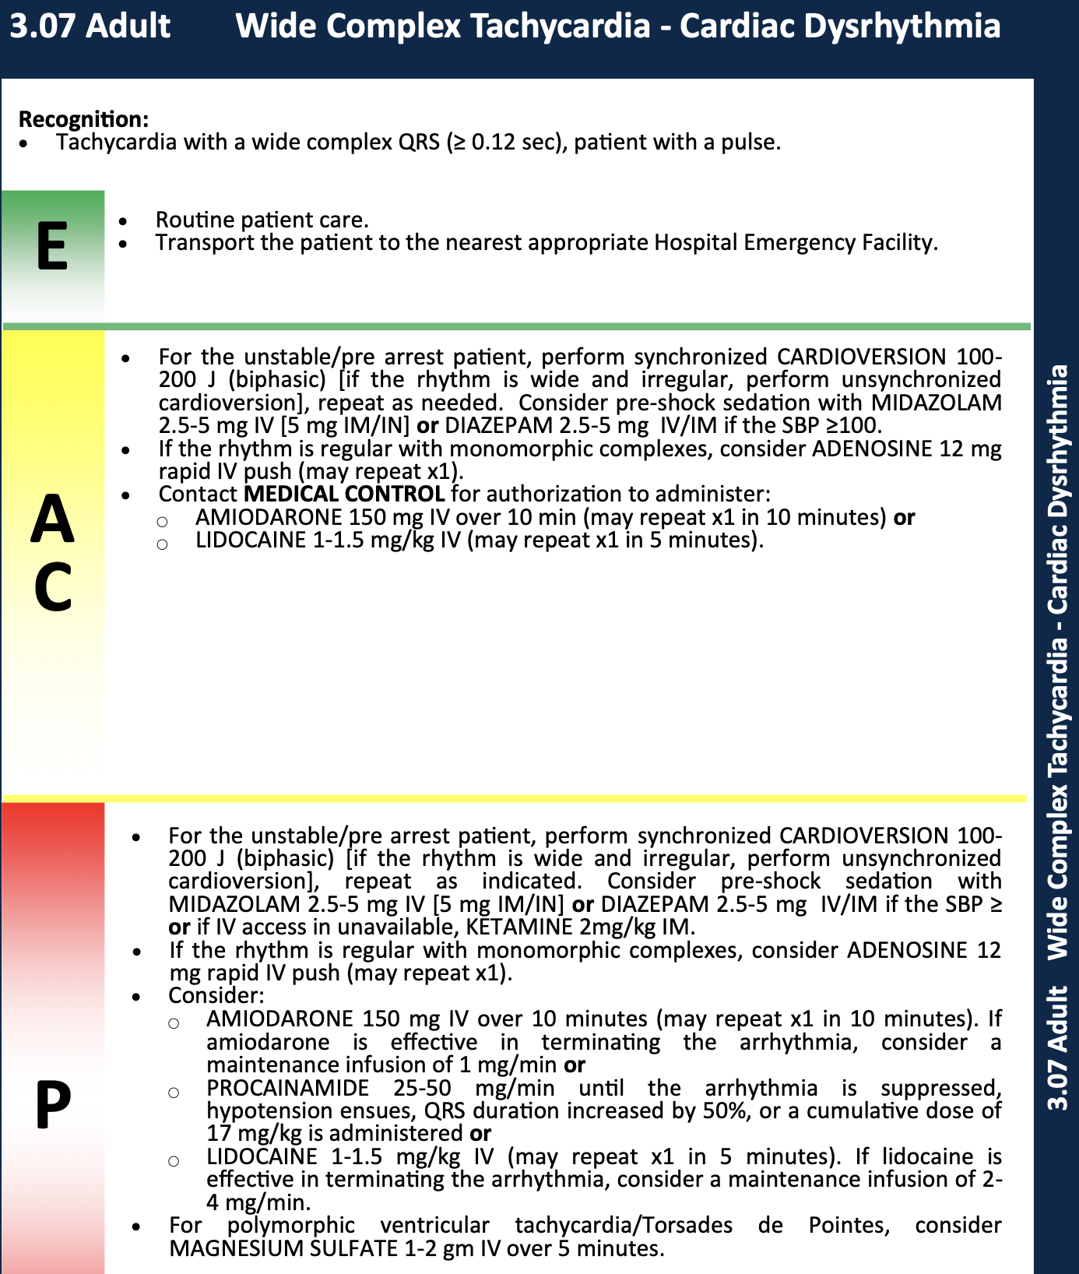
Notes:
Wide complex tachy cardias

Slide 26
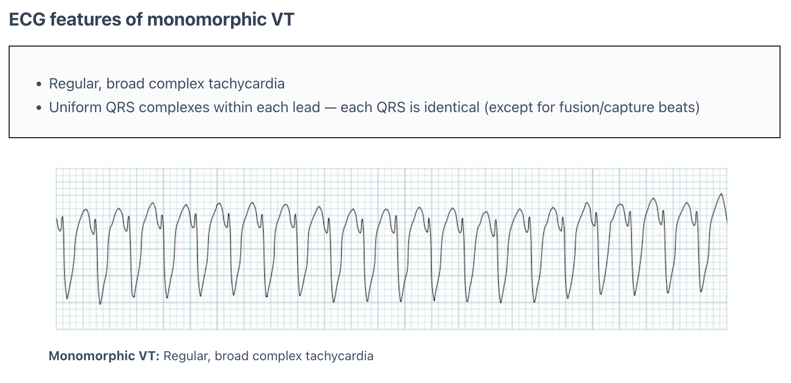
Regular Wide Complex: Ventricular Tachycardia
Notes:
Other ECG features suggestive of VT include:
Very broad complexes (>160ms)
Absence of typical RBBB or LBBB morphology
Extreme axis deviation (“northwest axis”)
AV dissociation (P and QRS complexes at different rates)
Capture beats — occur when the sinoatrial node transiently ‘captures’ the ventricles, in the midst of AV dissociation, to produce a QRS complex of normal duration
Fusion beats — occur when a sinus and ventricular beat coincide to produce a hybrid complex of intermediate morphology
Positive or negative concordance throughout the chest leads, i.e. leads V1-6 show entirely positive (R) or entirely negative (QS) complexes, with no RS complexes seen
RSR’ complexes with a taller “left rabbit ear”. This is the most specific finding in favour of VT. This is in contrast to RBBB, where the right rabbit ear is taller
VT is not a single entity
There are 4 types of VT that EM providers need to be aware of:
1. Scar mediated monomorphic VT – the classic VT we see in older patients with a cardiac history
->Rx: procainamide, as per the PROCAMIO study.
2. Polymorphic VT – usually related to a cardiac ischemic event
->Rx: amiodarone
3. Exercise induced non-sustained monomorphic VT – in young patients (e.g. 20’s)
->Rx: no ED treatment required; outpatient beta blockers
4. Catecholaminergic Polymorphic VT (CPVT): Heritable VT in young patients (teens/20’s) presenting as polymorphic or bidirectional with a LBBB pattern and inferior axis.
->Rx: IV beta blocker, AVOID amiodarone and procainamide
As per ACLS guidelines, If any tachydysrhythmia presents as unstable, the treatment of choice is synchronized electrical cardioversion.
For many stable patients, electrical cardioversion may be the preferred treatment of choice for VT. For example, electrical cardioversion should be considered in all patients with known heart disease and VT regardless of clinical stability, as the risks of antidysrhythmic medication are probably higher than those of electrical cardioversion in this patient population. Many patients with known heart disease and VT may not be considered “unstable” according to ACLS guidelines (those with hypotension, decreased LOA, acute heart failure or ischemic chest pain), but nonetheless may have poor cardiac output and be unable to tolerate antidysrhthmic medications. In patients with known LV dysfunction and VT, even with normal BP, consider incipient shock and immediate cardioversion. Remember that cardiac output can be dangerously low while the patient maintains a “normal” BP. Blood pressure ≠ cardiac output.
Next line stable is Pocainaimde 1st line drug of choice
20-50mg/min max 1 gram/17mg/kg
Amiodarone in MI or LV dysfunction
150mg over 10 mins w/ drip over 6 hours for 360mg total

Slide 27
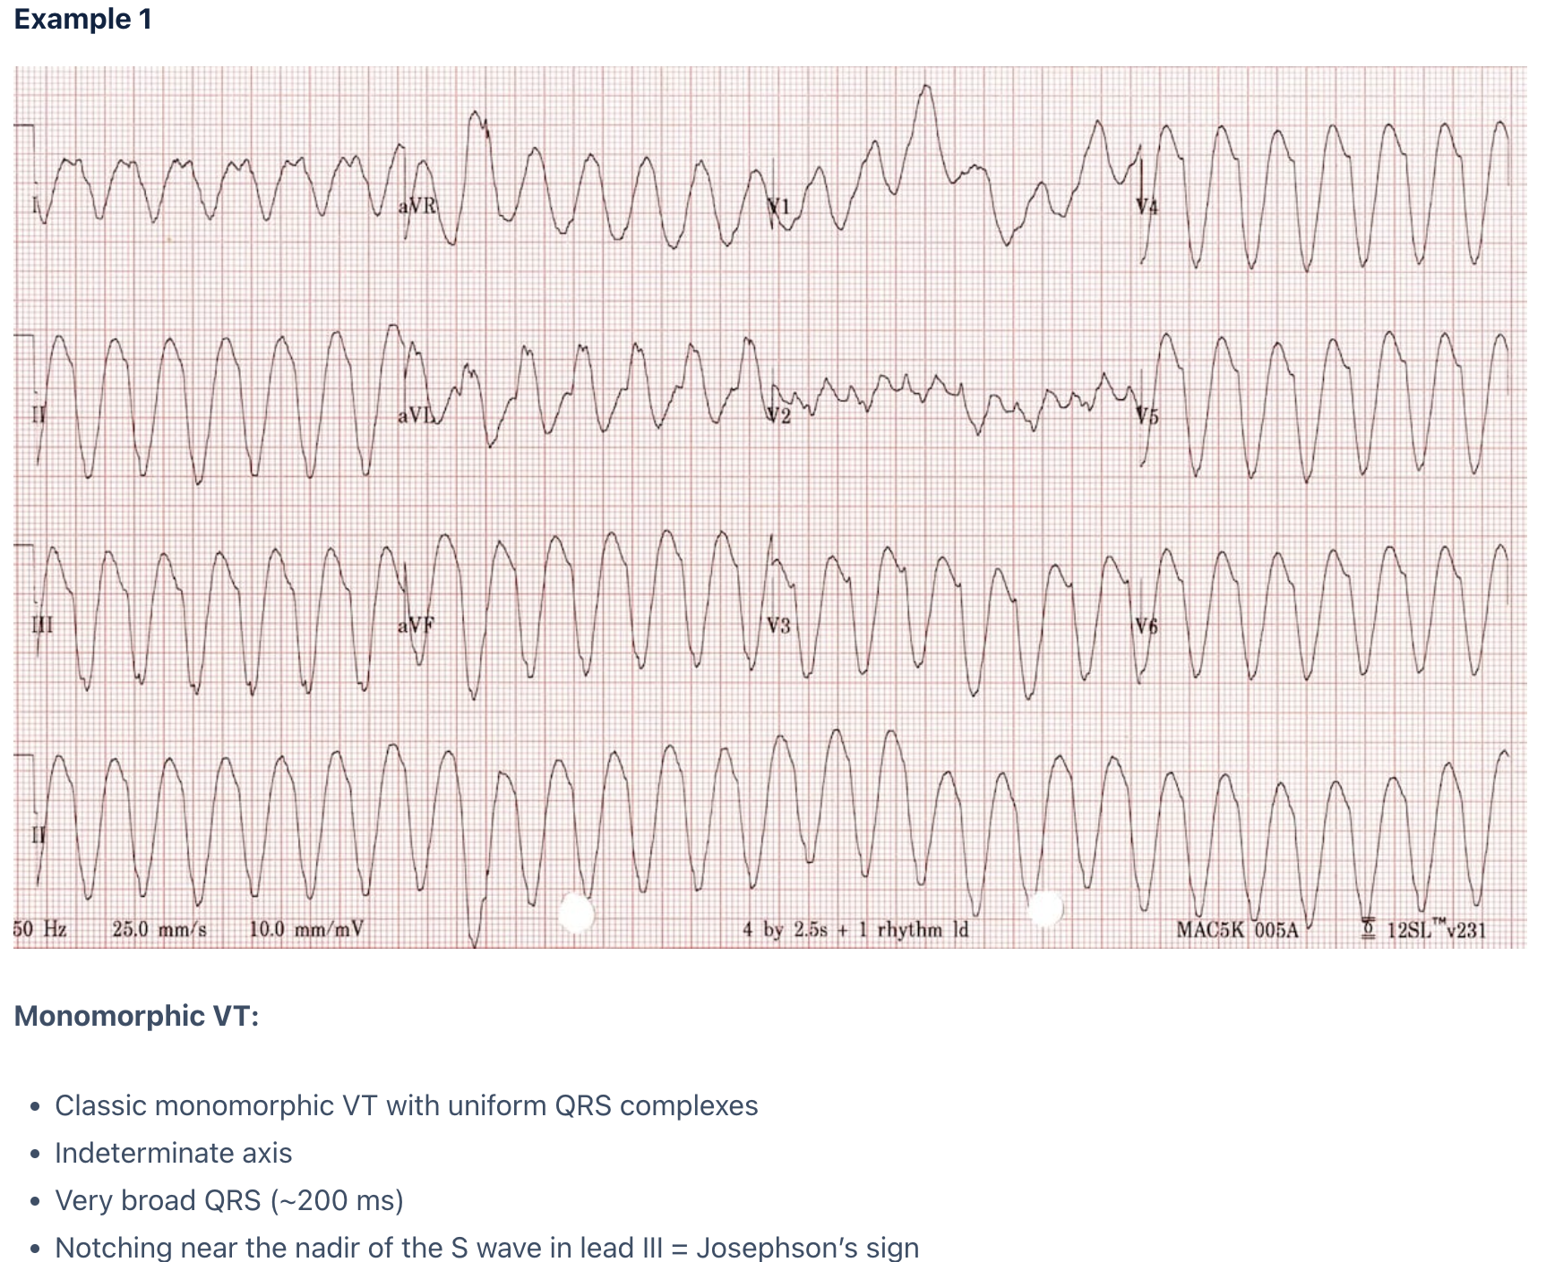
Notes:
Electrical cardioversion may be the preferred treatment of choice for VT. For example, electrical cardioversion should be considered in all patients with known heart disease and VT regardless of clinical stability, as the risks of antidysrhythmic medication are probably higher than those of electrical cardioversion in this patient population.
Avoid the “verapamil death test”! Do not give a calcium channel blockers to a patient with a wide complex tachycardia.
Other things to consider:
Hyperkalemia (HR usually < 120 bpm)
Sodium channel blocker toxicity (often very wide QRS > 200 ms)
Accelerated Idioventricular Rhythm (AIVR). This is a reperfusion rhythm often seen post-lytics for STEMI; Think of “slow VT”. The treatment is observation, not medication.

Slide 28
Interventions
Notes:
Management of Stable Ventricular Tachycardia
The 2016 PROCAMIO RCT trial compared IV procainamide and amiodarone for the treatment of acute but stable sustained monomorphic VT. Procainamide was associated with less major cardiac adverse events and a higher proportion of tachycardia termination within 40 minutes. Procainamide is currently considered to be the first line medication for sustained monomorphic VT in stable patients.
Indications for amiodarone in VT
While procainamide is currently considered to be the first line medication for stable sustained VT, there remain three important indications for amiodarone in the setting of VT:
1. Polymorphic VT related to cardiac ischemia
2. ICD patient with VT above detect rate (usually >175 bpm)
3. VT in the cardiac arrest patient
VT in the ICD patient
VT below detect (usually <175 bpm)
VT is too slow for ICD to recognize. Treat as you would any VT.
VT above detect (usually >175 bpm)
Recurrent episodes of VT. Treatment involves prevention, which is usually a combination of IV amiodarone, beta blockade and sedation. Consider causes such as ICD malfunction, electrolyte imbalance and severe CHF.
Magnet? If an ICD patient is not in VT but their ICD is delivering shocks, place a magnet on the ICD to put it into VVI mode (pacing preserved, shocking disabled).

Slide 29
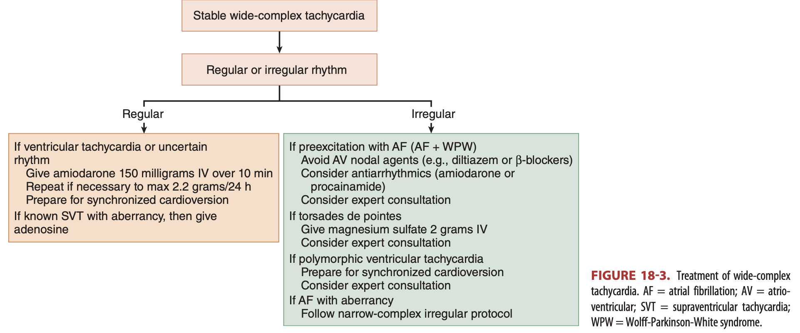

Slide 30
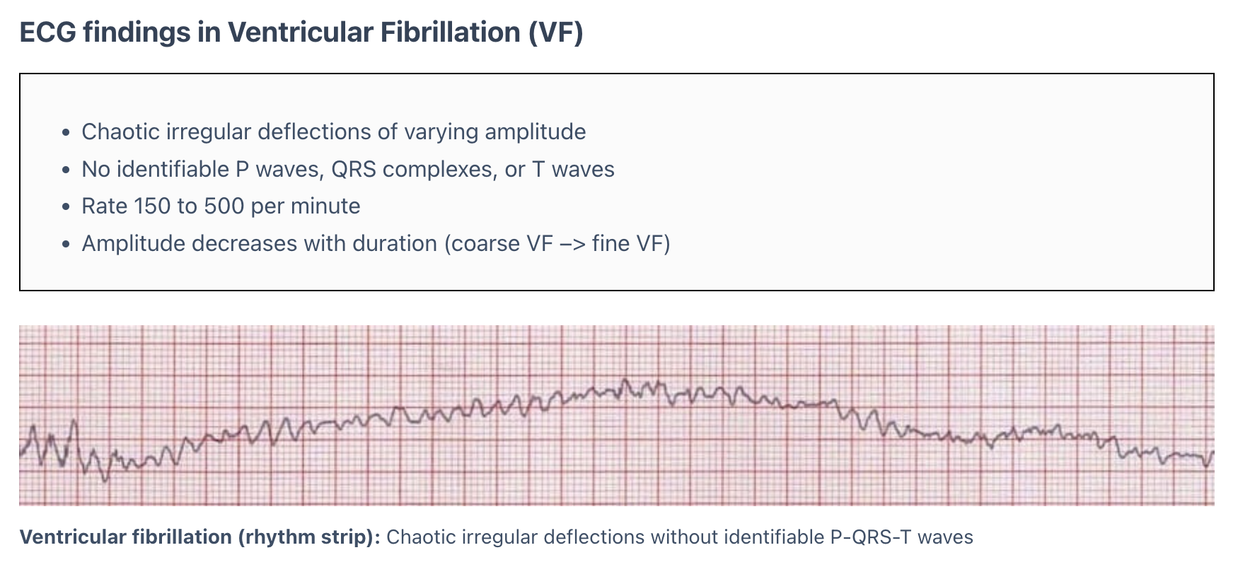
Irregular Wide Complex: Ventricular Fibrillation
Notes:
Clinical significance of VF
Ventricular fibrillation (VF) is the most important shockable cardiac arrest rhythm
The ventricles suddenly attempt to contract at rates of up to 500 bpm
This rapid and irregular electrical activity renders the ventricles unable to contract in a synchronised manner, resulting in immediate loss of cardiac output
The heart is no longer an effective pump and is reduced to a quivering mess
Unless advanced life support is rapidly instituted, this rhythm is invariably fatal
Prolonged ventricular fibrillation results in decreasing waveform amplitude, from initial coarse VF to fine VF, ultimately degenerating into asystole due to progressive depletion of myocardial energy stores
Shock Biphasic 200J
Then AMidoaron 300mg IVP if 2nd shock and 2 min of CPR fails
Lidocaine 1-1.5 mg/kg
Dual sequence, esmolo for electreical storm and stellate ganglion nerve blocks, fibrinolytics
Mechanism
In the presence of ischaemic heart disease VF may be preceded by:
Premature ventricular contractions (PVCs)
ST changes
R on T phenomenon
Sinus pause
QT prolongation
Ventricular tachycardia
Supraventricular arrhythmias
Sinus tachycardia

Slide 31
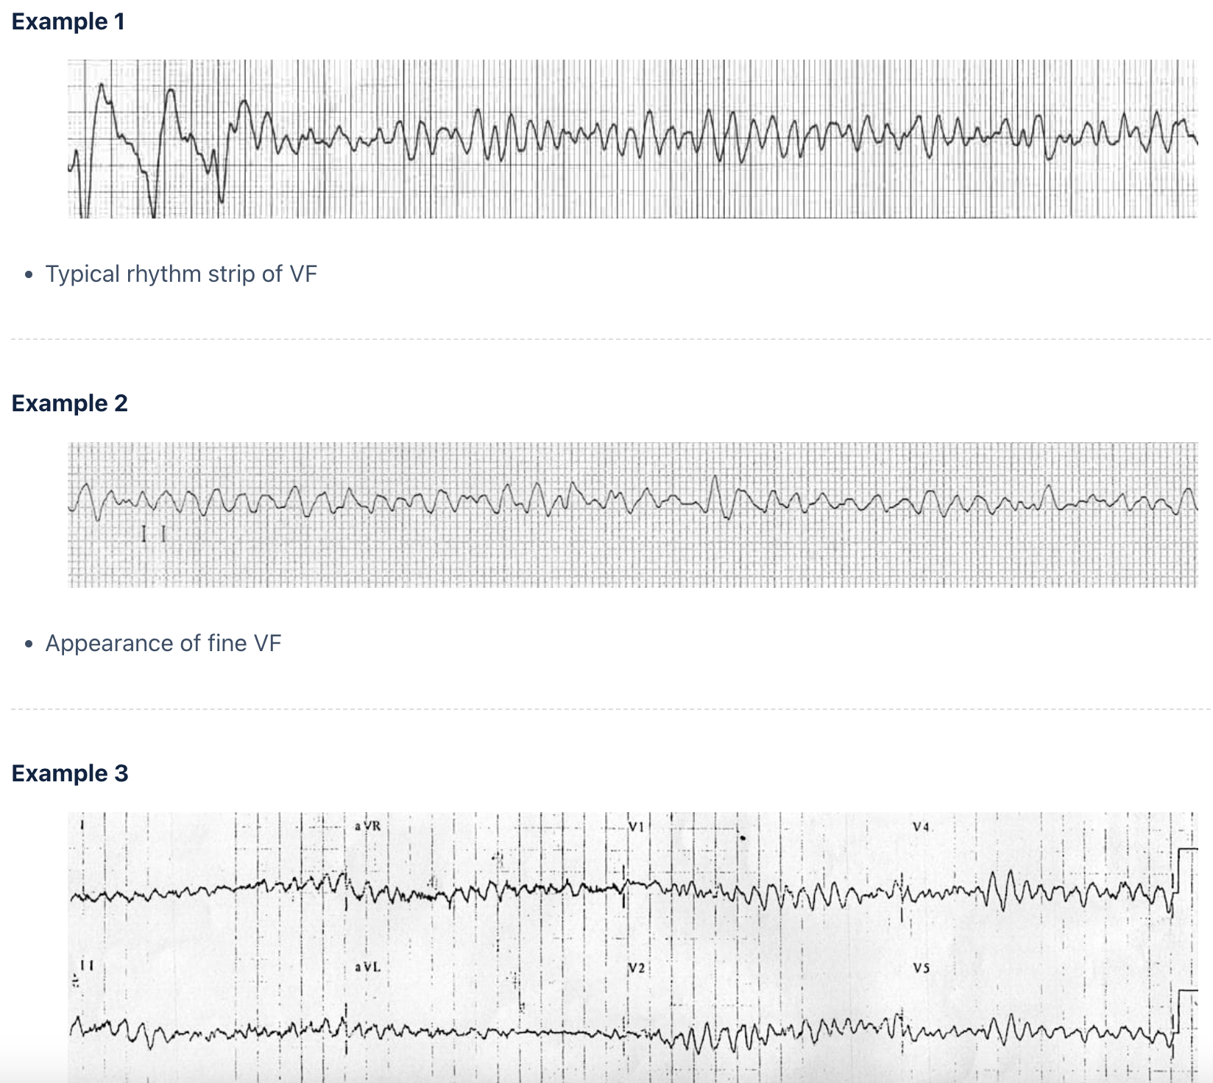
Notes:
Causes of Ventricular Fibrillation (VF)
Cardiac
Myocardial ischemia / infarction
Cardiomyopathy (dilated, hypertrophic, restrictive)
Channelopathies e.g. Long QT (acquired / congenital) causing TdP –> VF and Brugada syndrome
Aortic stenosis
Aortic dissection
Myocarditis
Cardiac tamponade
Blunt trauma (Commotio Cordis)

Slide 32
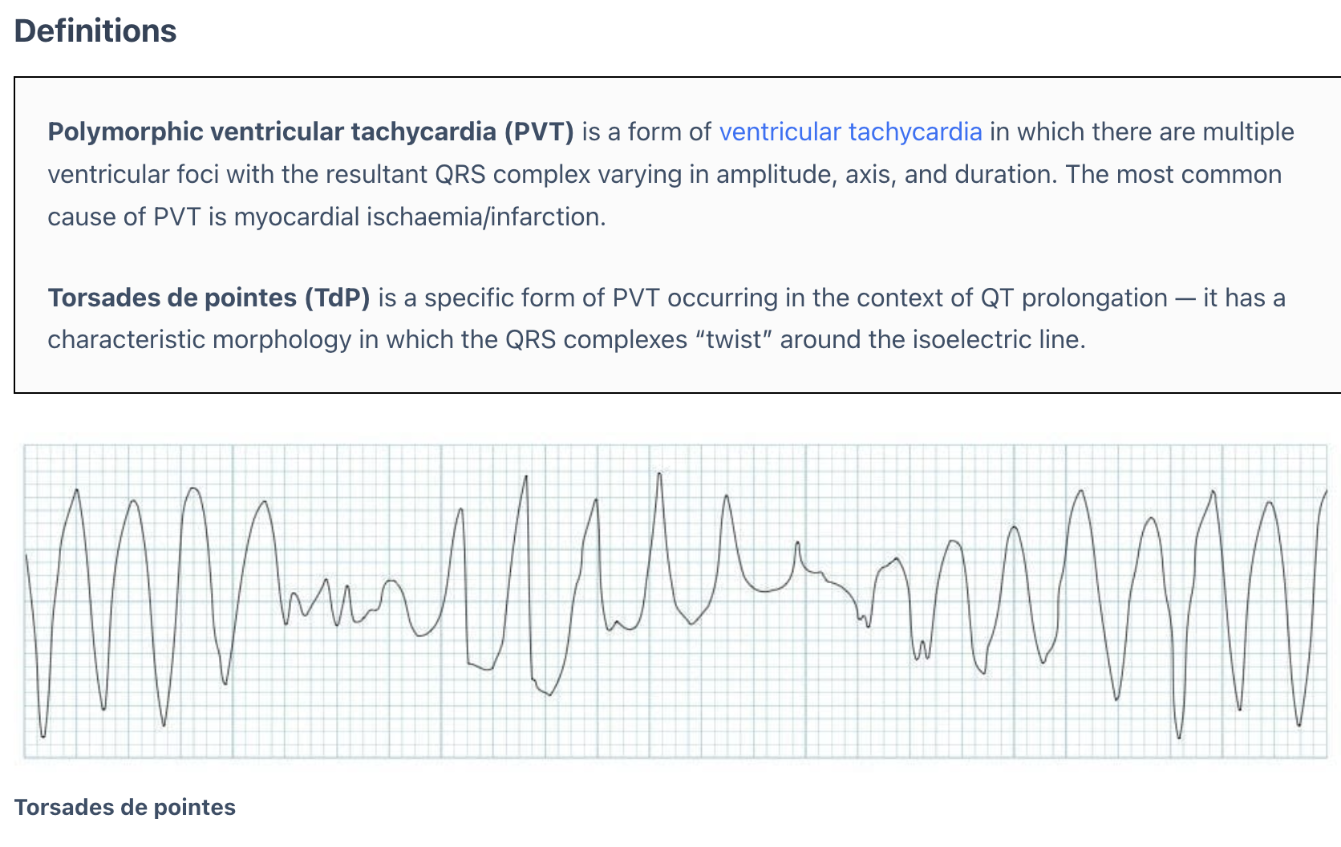
Irregular Wide Complex Torsades De Pointes
Notes:
Pathophysiology of TdP
Give Mg 2mg
A prolonged QT reflects prolonged myocyte repolarisation due to ion channel malfunction
This prolonged repolarisation period also gives rise to early after-depolarisations (EADs)
EADs may manifest on the ECG as tall U waves; if these reach threshold amplitude they may manifest as premature ventricular contractions (PVCs)
TdP is initiated when a PVC occurs during the preceding T wave, known as ‘R on T’ phenomenon
The onset of TdP is often preceded by a sequence of short-long-short R-R intervals, so called “pause dependent” TDP, with longer pauses associated with faster runs of TdP
Electrocardiographic Pearls
During short runs of TdP or single lead recording the characteristic “twisting” morphology may not be apparent
Bigeminy in a patient with a known long QT syndrome may herald imminent TdP
TdP with heart rates > 220 beats/min are of longer duration and more likely to degenerate into VFib

Slide 33
Notes:
Torsades de Pointes:
Frequent PVCs with ‘R on T’ phenomenon trigger a run of polymorphic VT which subsequently begins degenerates into VF
QT interval is difficult to see because of artefact but appears slightly prolonged (QTc ~480ms), making this likely to be TdP
This combination of mildly prolonged QTc and frequent PVCs / bigeminy is commonly seen in acute myocardial ischaemia — these patients are at high risk of deterioration into PVT / VF

Slide 37
Considerations and Pearls
Notes:
PEARLS:
For patients with sinus tachycardia (HR ≥ 100 to 220 minus the patient’s age), search for and treat the underlying cause (anxiety, fever, pain, dehydration, hypoxia, sepsis).
Consider a fluid bolus (NORMAL SALINE 500-1000 ml IV) in patients with a history suggestive of dehydration and no evidence of overt heart failure/pulmonary edema.
If cardioversion is needed and it is impossible to synchronize the defibrillator, deliver an unsynchronized shock (defibrillation).
Calcium channel blockers (diltiazem, verapamil) are contraindicated in patients with a known diagnosis of or with ECGs findings consistent with Wolff-Parkinson-White (WPW) syndrome. Arrhythmias with suspicion of Wolff-Parkinson-White (WPW) syndrome should be treated with amiodarone.
The initial dose for ADENOSINE should be reduced to 6 mg and the repeat dose should be reduced to 12 mg in patients taking dipyridamole and those that are status post cardiac transplant.
Maximum dose of antiarrhythmic should be given prior to changing to another antiarrhythmic.
Theophylline and caffeine (methylxanthines) competitively antagonize adenosine's effects; an increased dose of adenosine may be required.
Adenosine is contraindicated in patients with sinus tachycardia, atrial fibrillation or atrial flutter.
The presence of the following factors increase the likelihood of ventricular tachycardia in the patient with a wide complex tachycardia: age > 35 yo, history of ischemic heart disease/MI, history of structural heart disease, CHF, cardiomyopathy or a family history of sudden cardiac death.
If the rhythm is regular with monomorphic QRS complexes, consider VT or SVT.
If the rhythm is irregular with monomorphic complexes, consider pre-excitation or atrial
fibrillation with aberrancy.

Slide 38
Medications
New Medications
Drug-Drug Interactions
Renally and Hepatically cleared medications
Notes:
Especially look for:
New medications.
Drug-drug interactions.
Adenosine
Digoxin
Procainamide
Flecanide single pill

Slide 39
Upcoming Grand Rounds
Sepsis and Infectious Disease
April 17th 6PM
Pre-Hospital Management of Orthopedic and Extremity Injuries
May 15th 6PM

Slide 40
Thanks! Questions?
Resources
Life In The Fast Lane
https://litfl.com/tachycardia-ddx/
Emergency Medicine Cases
https://emergencymedicinecases.com/tachydysrhythmias/
Core EM
https://coreem.net/core/a-simplified-approach-to-tachydysrhythmias/

